Slide 1


PYTHON
PROJECT
PACE UNIVERSITY
TEAM MEMBERS:
MAHITH GEALLAPALLY
JEGAN NADAR
ADITI SHRIVASTAVA

Slide 2

CONTENT
01
INTRODUCTION
02
PROBLEM DEFINITION
03
DATASET USED
04
EDA
05
CONCLUSION

Slide 3

INTRODUCTION
Welcome to our Superstore data analysis project! With a rich dataset encompassing sales, profits, and customer information, we embark on a journey to uncover valuable insights. Through Python-based analysis, we aim to optimize operations, identify growth opportunities, and enhance customer experiences. Let's dive into the data-driven world of Superstore retail!

Slide 4
PROBLEM DEFINITION
Our Superstore faces challenges in maximizing profitability and customer satisfaction. By analyzing sales trends, factors influencing profits, and customer behaviors, we seek to identify bottlenecks and opportunities for improvement. The goal is to optimize operations and tailor strategies to enhance business performance in the competitive retail landscape.

Slide 5

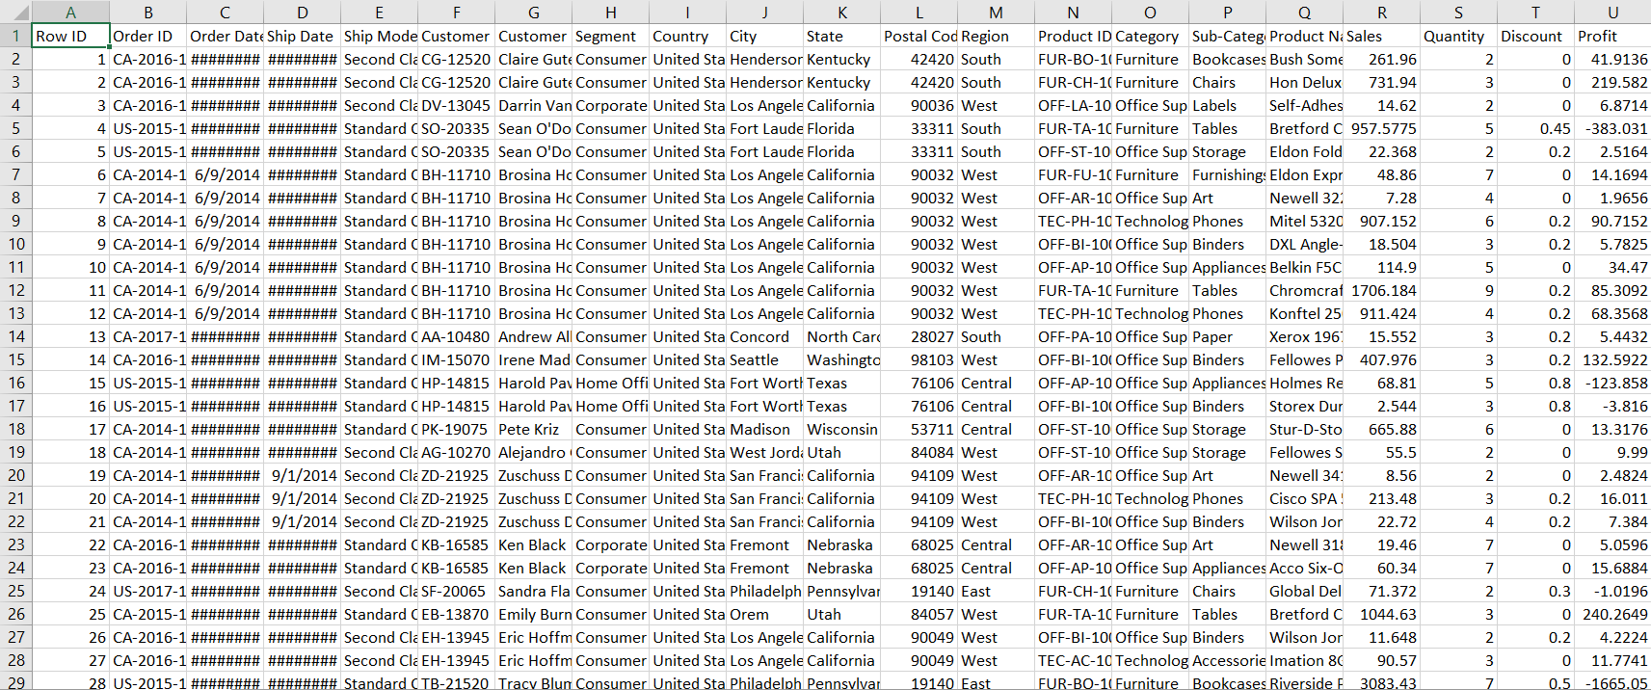
DATA USED

Slide 6
DATA USED
We have used an unstructured data of the superstore. The key factors we are being used from the dataset are Sales, Quantity, Profit and Category. The unstructured data is cleaned by dropping NULL values and deleting any duplicate values. Therefore, using the dataset to visualize in the form of boxplot, scatter plot and pairplot. Moreover, making use of the dataset to get the essential outcome where we can determine how the sales of products can be increased.

Slide 7
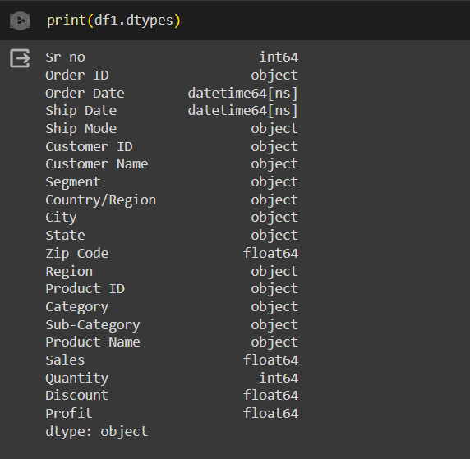
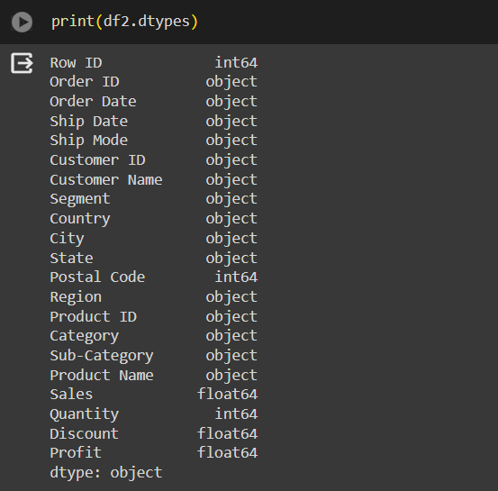


EDA
CHECKING FOR DATATYPES IN DATA 1
CHECKING FOR DATATYPES IN DATA 2

Slide 8
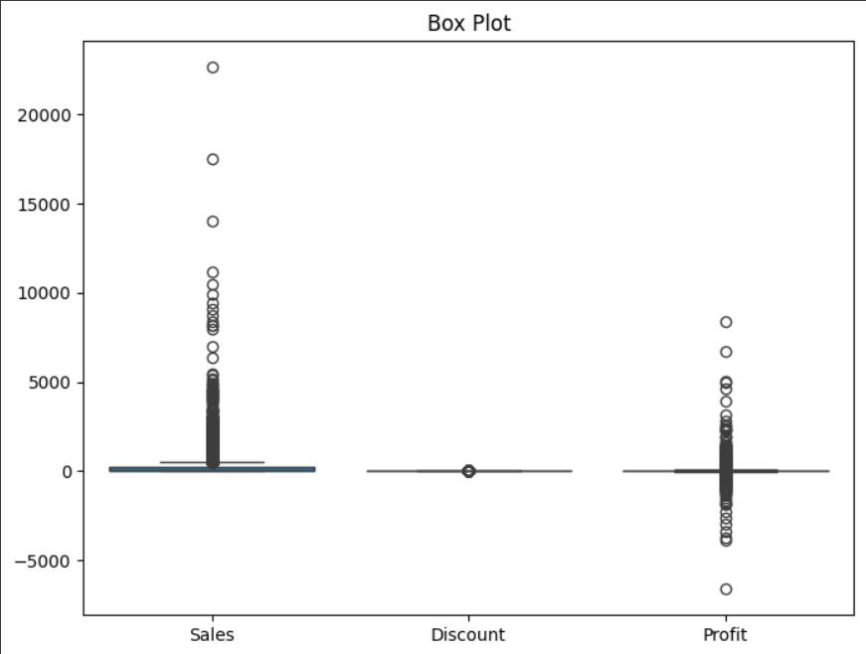
BOX PLOT

Slide 9
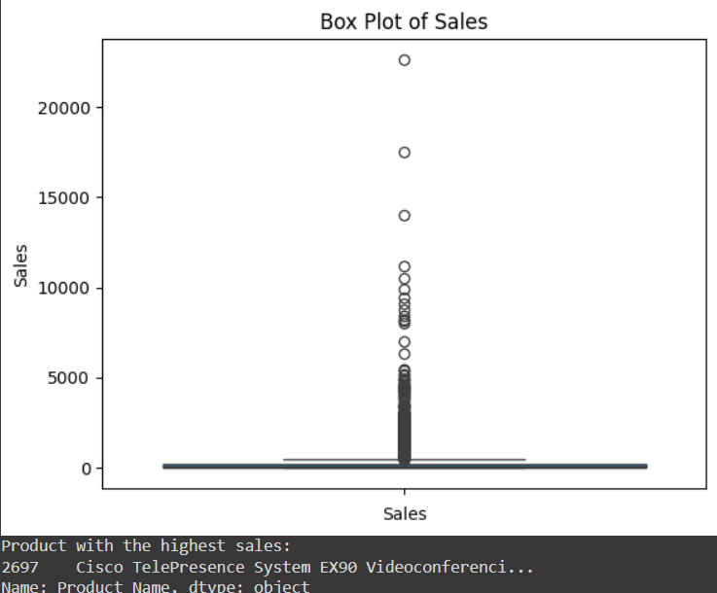
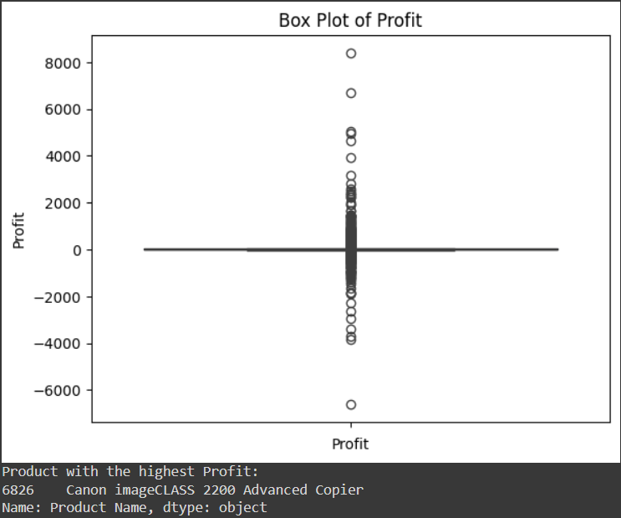
BOX PLOT
BOX PLOT FOR SALES
BOX PLOT FOR PROFIT

Slide 10
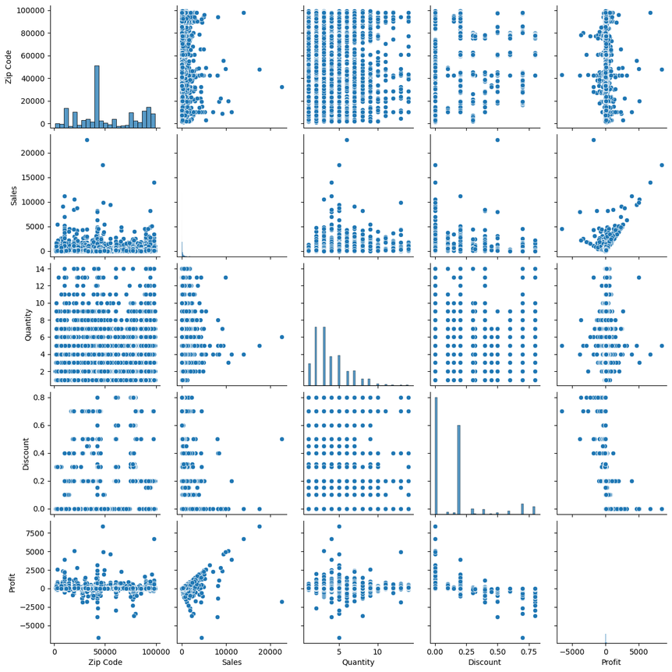
PAIR PLOT
PAIR PLOT OF THE DATASET

Slide 11
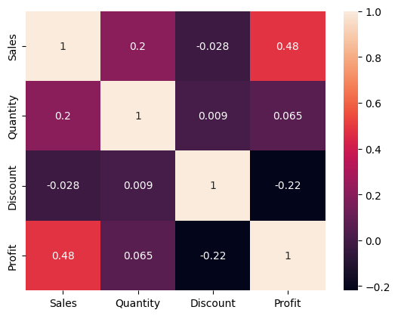

CORRELATION MATRIX
HEAT MAP OF THE DATASET

Slide 12
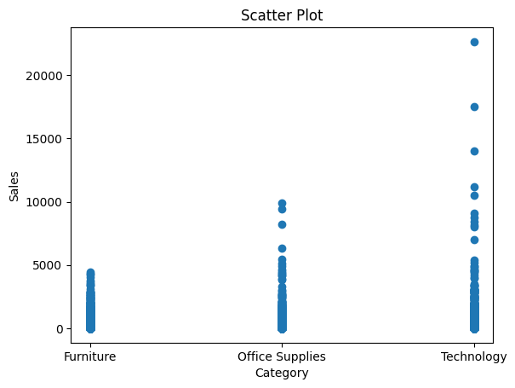
SCATTER PLOT
SALES X CATEGORY

Slide 13
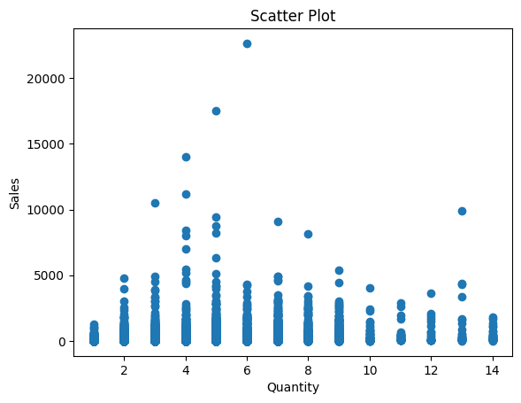
SCATTER PLOT
SALES X QUANTITY

Slide 14
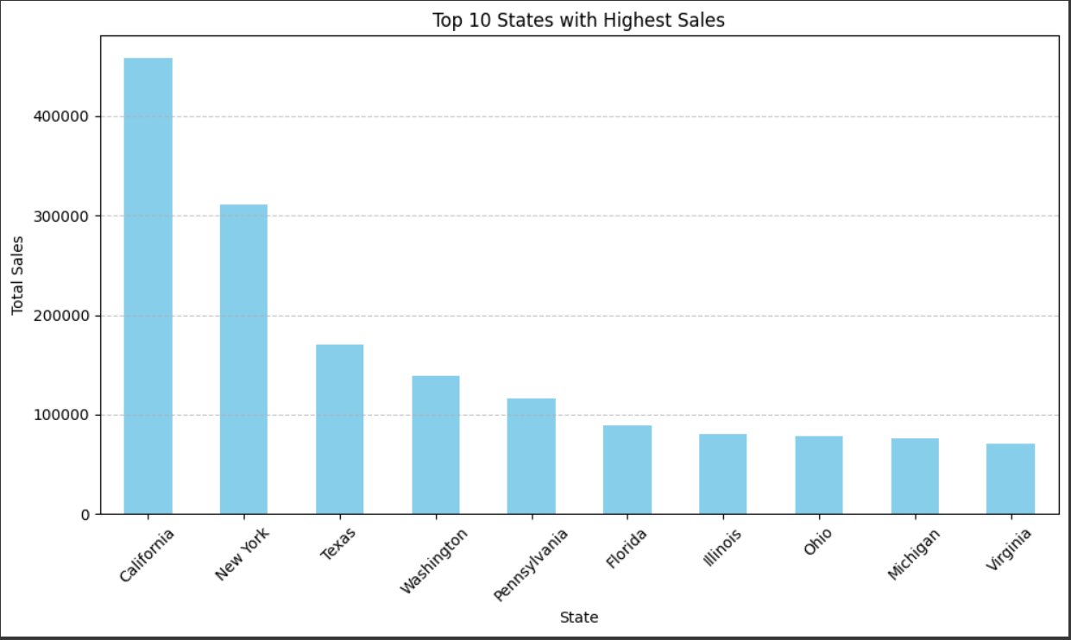
BAR GRAPH
TOP 10 SALES WITH HIGHEST SALES

Slide 15
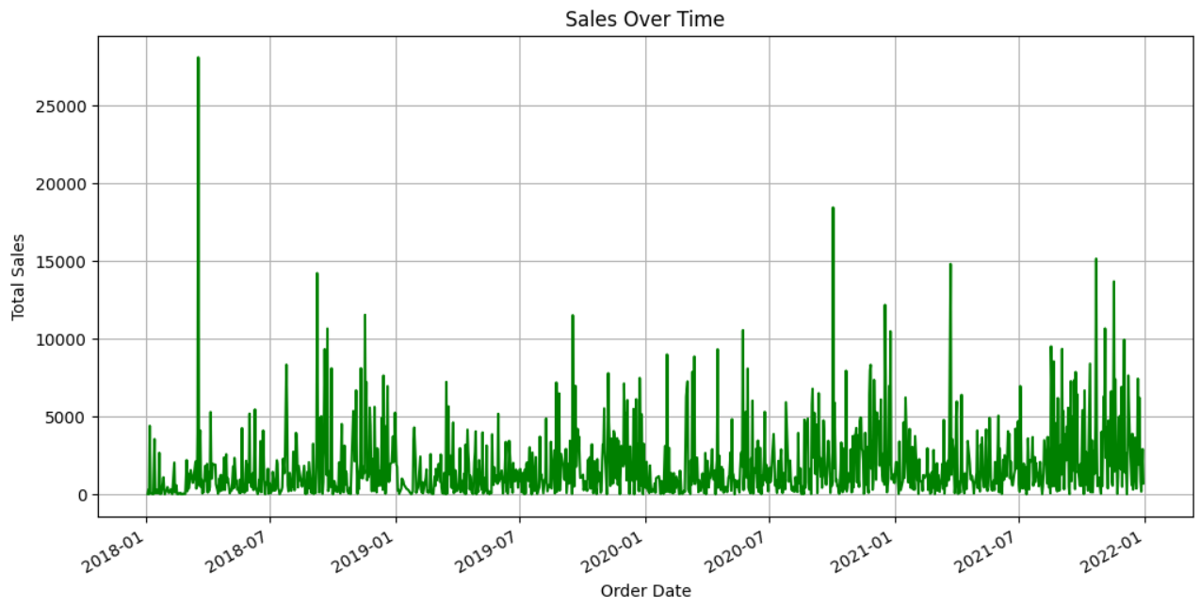
TIME SERIES PLOT
SALES OVER TIME

Slide 16
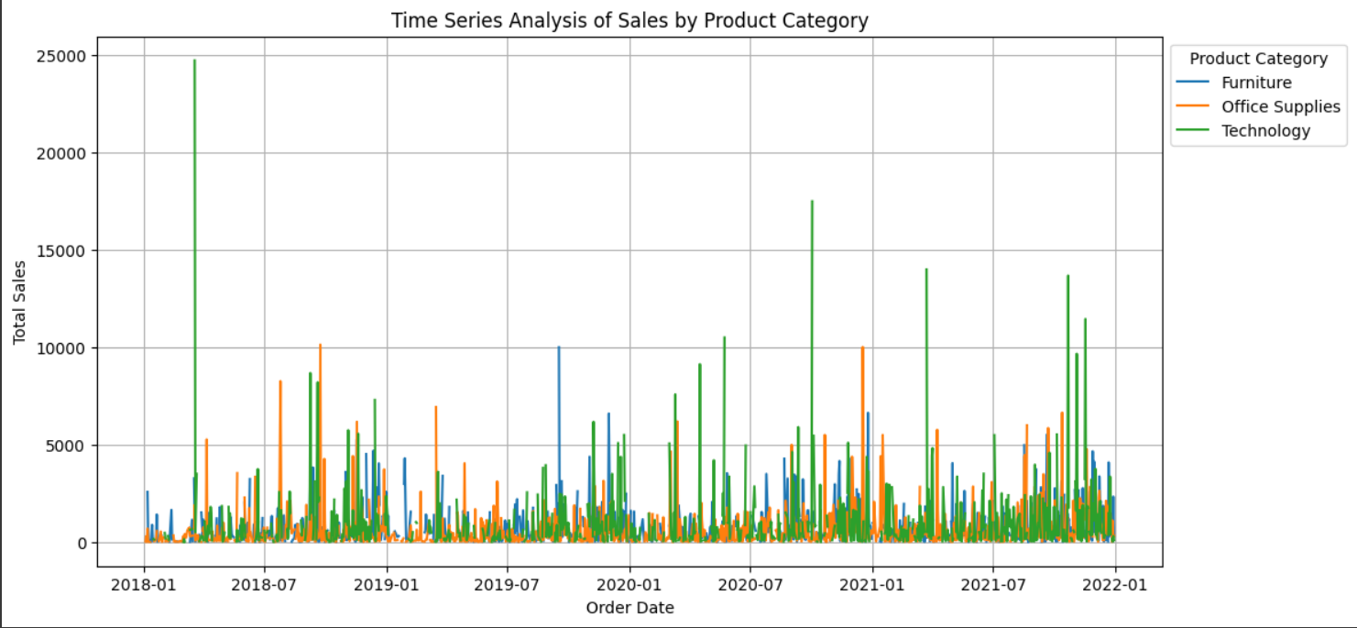
TIME SERIES PLOT
SALES BY PRODUCT CATEGORY

Slide 17
CONCLUSION
In conclusion, our analysis of Superstore data revealed actionable insights to drive business growth. By optimizing operations, understanding customer preferences, and implementing data-driven strategies, we can enhance profitability and customer satisfaction. This project underscores the power of data analytics in unlocking the Superstore's full potential.

